Slide 1
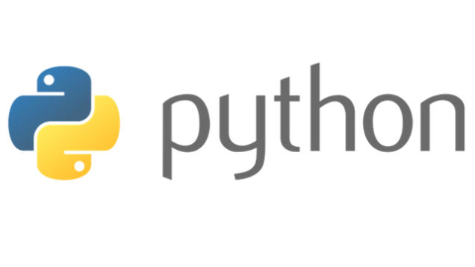
Course Id :INT 213

Slide 2
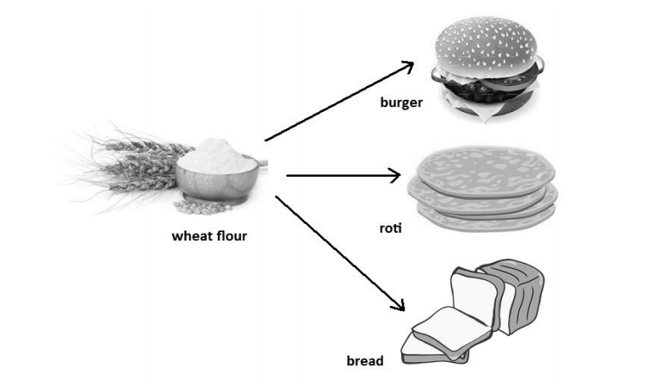
Polymorphism
Polymorphism is a word that came from two Greek words, poly means many and morphos means forms. If something exhibits various forms, it is called polymorphism.
Let’s take a simple example in our daily life. Assume that we have wheat flour. Using this wheat flour, we can make burgers, rotis, or loaves of bread. It means same wheat flour is taking different edible forms and hence we can say wheat flour is exhibiting polymorphism.

Slide 3
Operator Overloading
We know that an operator is a symbol that performs some action. For example, ‘+’ is an operator that performs addition operation when used on numbers.
When an operator can perform different actions, it is said to exhibit polymorphism.

Slide 4
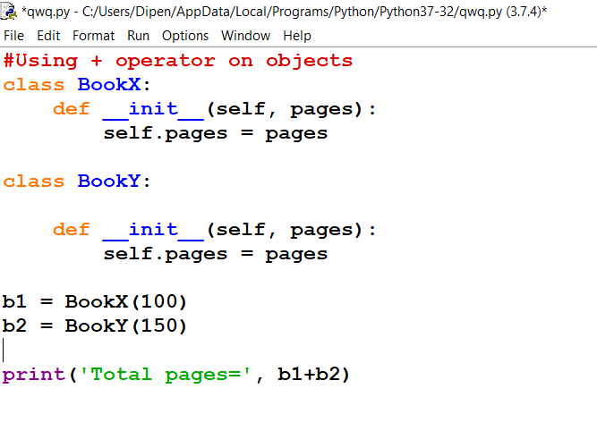
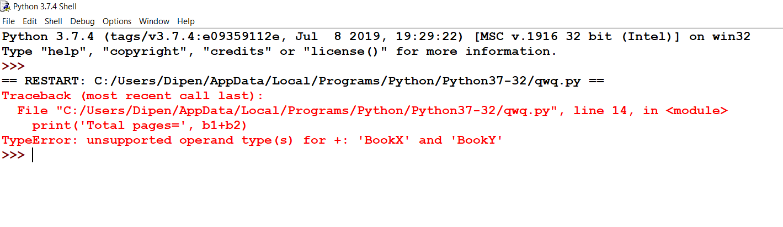
A Python program to use addition operator to add the contents of two objects.

Slide 5
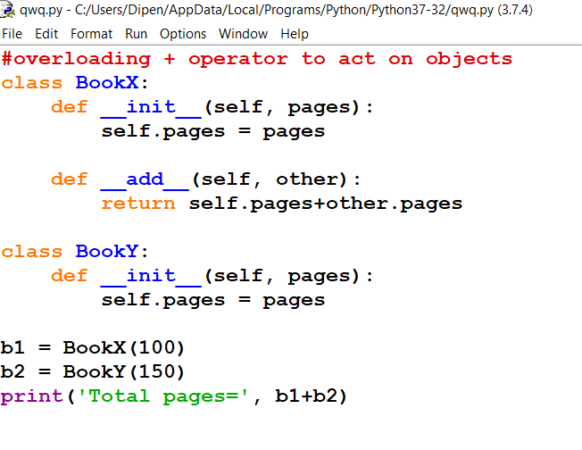
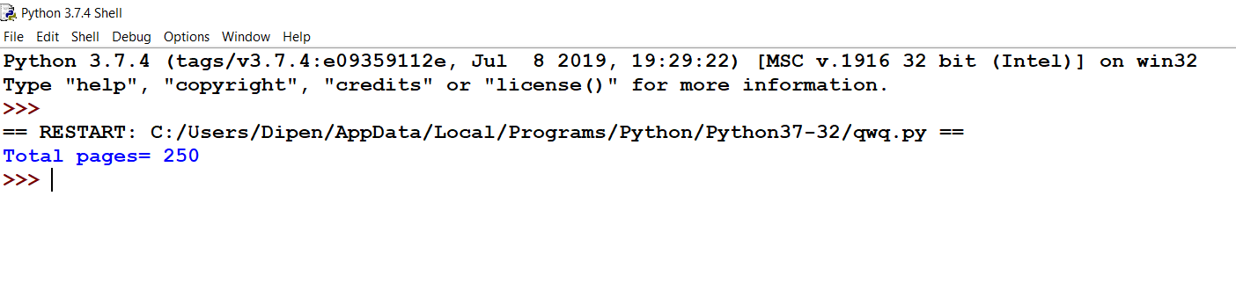
A Python program to use addition operator to add the contents of two objects.

Slide 6
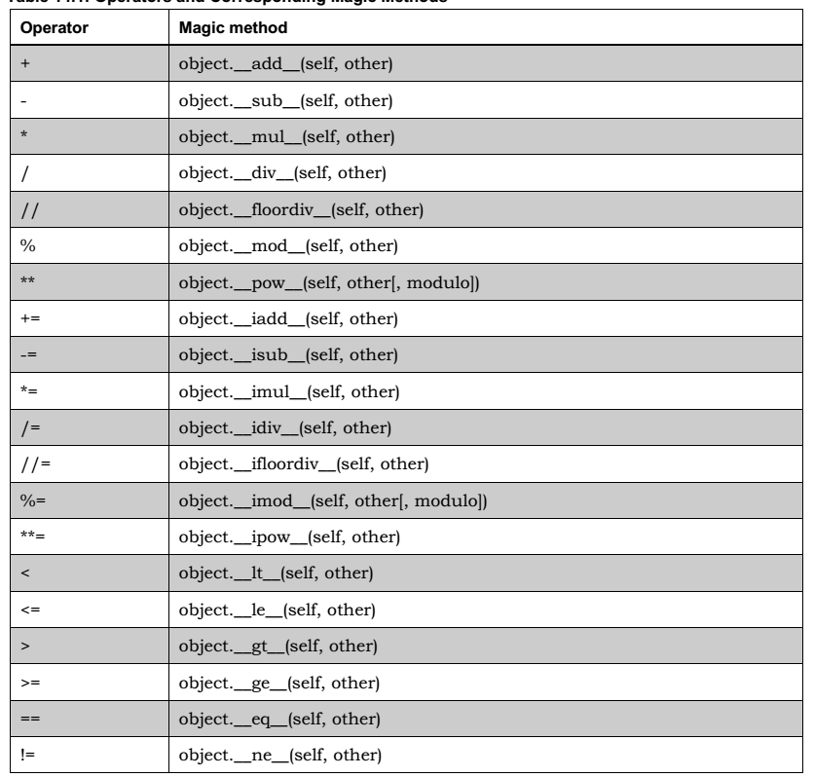
Operators and corresponding methods

Slide 7
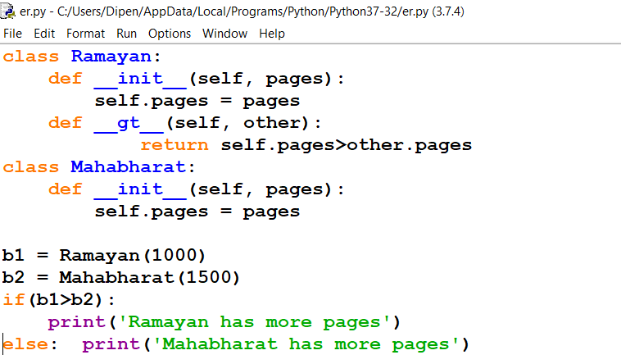
A Python program to overload greater than (>) operator to make it act on class objects.

Slide 8
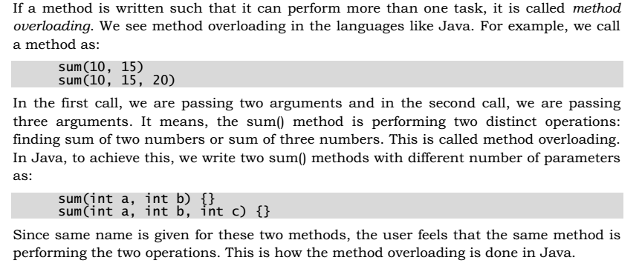
Method overloading

Slide 9
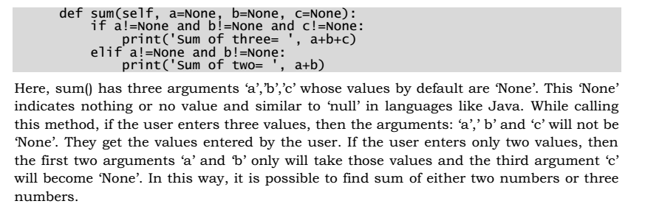
Method Overloading
Method overloading is not available in Python. Writing more than one method with the same name is not possible in Python. So, we can achieve method overloading by writing same method with several parameters.
The method performs the operation depending on the number of arguments passed in the method call. For example, we can write a sum() method with default value ‘None’ for the arguments as:

Slide 10
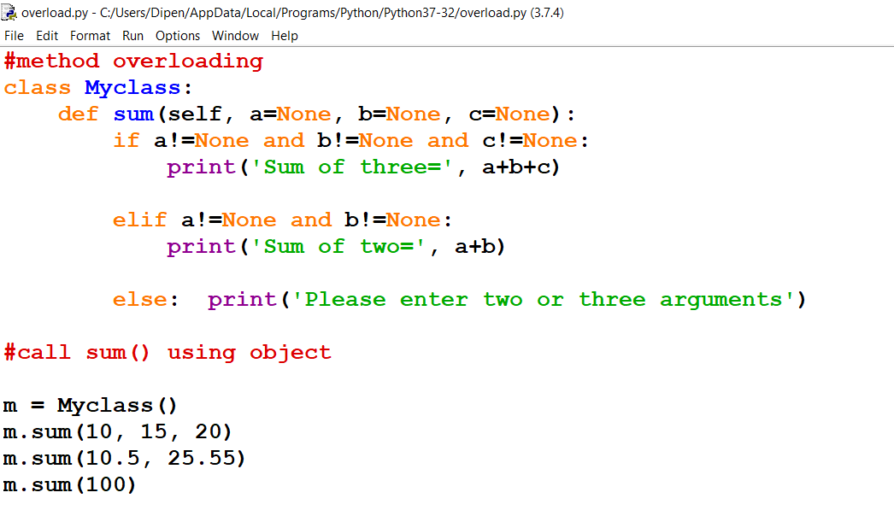
A Python program to show method overloading to find sum of two or three numbers.

